Slide 1

Wine Quality Prediction
Presented By:
Rudrakshi - 2210990747 (G-12)
Rudraksh Kapoor - 2210990746 (G-12)

Slide 2
INDEX
01.
02.
03.
04.
05.
06.
Introduction
Problem Statement
Data Description
Overview of Project
What we need to solve?
Information related to Data Set
Proposed Design
Results
References
Features Description
Outcomes of our Project.
References Used.

Slide 3

01.
INTRODUCTION

Slide 4
Introduction
Wine quality is a crucial factor in the wine industry, influencing consumer preferences and market value. This Python script aims to develop a machine learning model for accurately predicting wine quality based on various physicochemical properties. By analyzing a dataset containing information about different wine samples, we explore features such as acidity levels, residual sugar, and alcohol content. Through data preprocessing and the implementation of a Random Forest Classifier, we train a predictive model to classify wines as good or bad quality. Additionally, we incorporate a user-friendly Streamlit interface, allowing users to input specific wine characteristics and receive real-time quality predictions. This approach enhances our understanding of factors influencing wine quality and provides a practical tool for the wine industry.
Objectives:
Develop a robust machine learning model to accurately predict wine quality based on various physicochemical properties, such as acidity levels, residual sugar, and alcohol content.
Perform comprehensive data analysis and visualization to gain insights into the dataset and understand the relationships between different features and wine quality.
Create a user-friendly interface using Streamlit, allowing users to input specific wine characteristics and obtain real-time quality predictions, making the model accessible and practical for the wine industry.

Slide 5
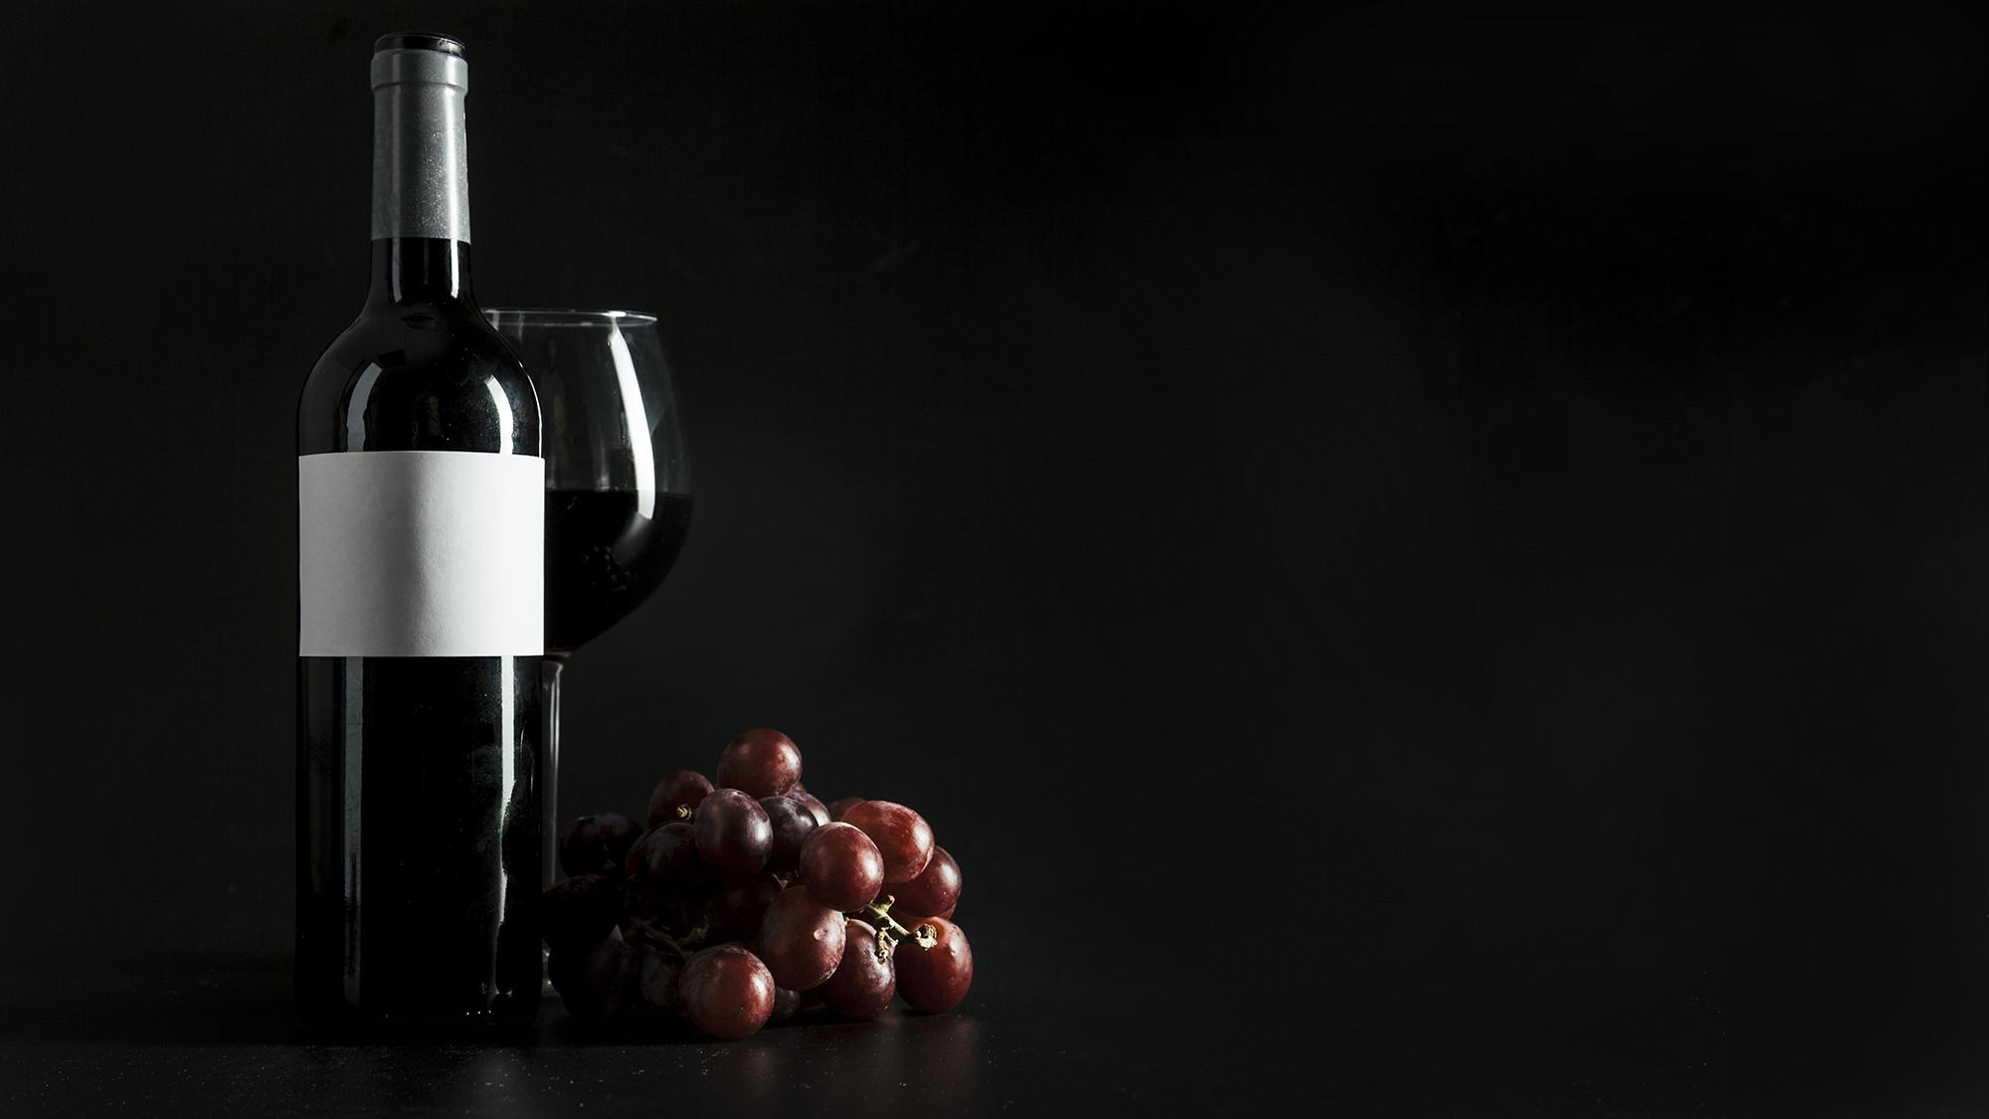
PROBLEM STATEMENT
02.

Slide 6
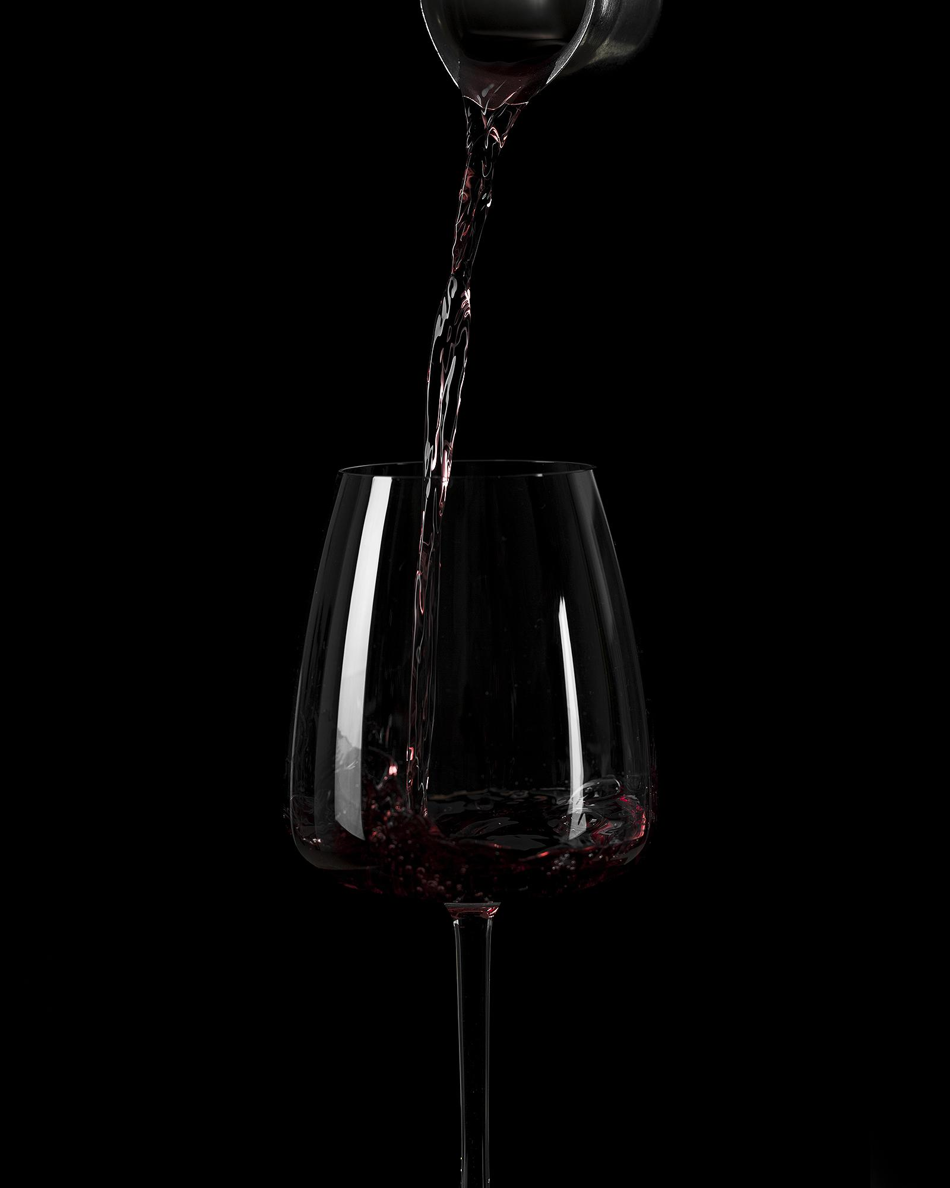

PROBLEM STATEMENT
The wine industry lacks an objective and efficient method to assess wine quality, currently relying on subjective evaluations by experts, which can be time-consuming and prone to bias.
1.
The project aims to develop a machine learning model capable of accurately predicting wine quality based on measurable physicochemical properties, such as acidity levels, residual sugar, and alcohol content, by leveraging data analysis techniques and machine learning algorithms.
2.
The proposed solution involves integrating the predictive model into a user-friendly interface, providing a reliable and consistent approach to wine quality assessment, enabling informed decisions for industry stakeholders, optimizing production processes, and
enhancing consumer satisfaction.
3.

Slide 7



03.
DATA DESCRIPTION

Slide 8
DATA DESCRIPTION
The dataset used in the code is named "WineQT.csv" and is loaded from a CSV file. The source or origin of the dataset is not explicitly mentioned in the code.
Dataset Source
The dataset contains 12 features related to the properties of wine samples. These features include fixed acidity, volatile acidity, citric acid, residual sugar, chlorides, free sulphur dioxide, total sulphur dioxide, density, pH, sulphates, and alcohol content.
Features
The dataset's target variable, "quality," denotes wine quality as either good (score of 7 or higher, labeled as 1) or bad (score below 7, labeled as 0).
Target Variable

Slide 9
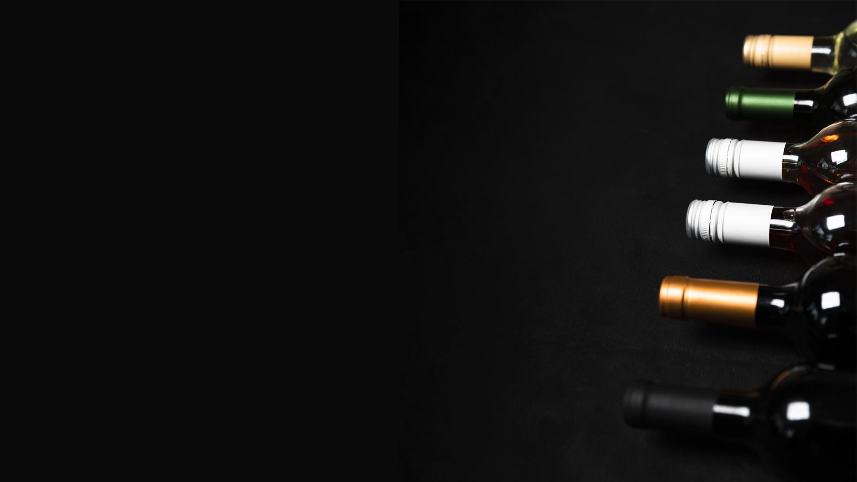
PROPOSED DESIGN
04.

Slide 10
PROPOSED DESIGN
Data Preprocessing: Perform data cleaning, handling missing values, and feature engineering to prepare the dataset for modeling.
Feature Selection: Utilize techniques like correlation analysis and feature importance to identify the most relevant features for predicting wine quality.
Model Training: Implement machine learning algorithms, such as Random Forest Classifier, to train a predictive model on the preprocessed dataset.
Model Evaluation: Assess the performance of the trained model using metrics like accuracy, precision, recall, and F1-score, and employ techniques like cross-validation for robust evaluation.
User Interface: Develop an intuitive and user-friendly interface using Streamlit, allowing users to input wine characteristics and obtain quality predictions in real-time.

Slide 11
LIBRARIES USED
Numpy
Pandas
Essential for scientific computing, especially for large arrays and mathematical functions.
Powerful for data analysis and manipulation, ideal for structured and time series data.
Matplotlib
Seaborn
Versatile plotting library for creating diverse visualizations.
Simplifies crafting informative statistical graphics, built on Matplotlib.
Scikit-learn
Streamlit
Comprehensive machine learning library with various algorithms and utilities.
Python framework for creating interactive web apps focused on data.

Slide 12
MODEL DESCRIPTION
Model
Features
Target
Utilizes Random Forest Classifier from Scikit-learn, an ensemble method combining decision trees for better accuracy and reduced overfitting.
Uses various physicochemical properties of wine, excluding "quality", like acidity, sugar content, sulfur dioxide levels, etc.
"Quality" is binarized into good (1) or bad (0) based on a threshold of 7.
Data
Evaluation
Splits dataset into training and testing sets using `train_test_split`.
Assesses model performance with metrics like accuracy, precision, recall, F1-score, and confusion matrix, aiming for accurate wine quality prediction.

Slide 13

05.
RESULTS

Slide 14
OUR METRICS
90%
98%
90%
94%
Precision
Recall
Accuracy
F1 Score

Slide 15
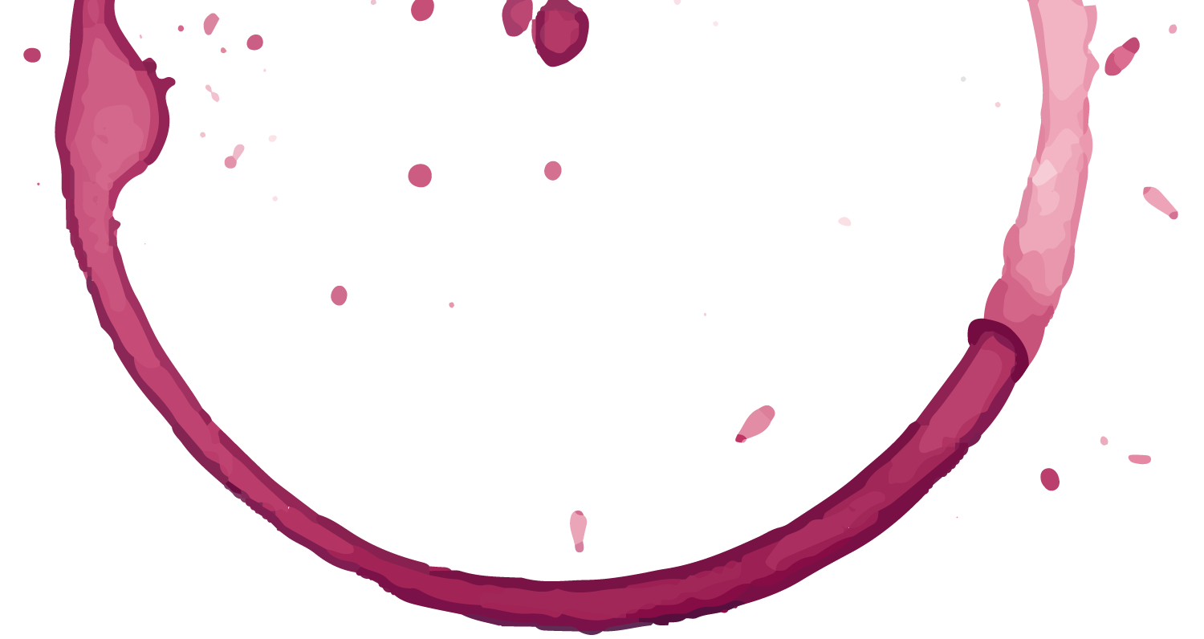

06.
XL
REFERENCES

Slide 16
INFOGRAPHICS CAN HELP
IBM Random Forest
Kaggle Wine Quality Dataset
Link
Link
Streamlit Documentation
Scikit-learn Documentation
Link
Link

Slide 17
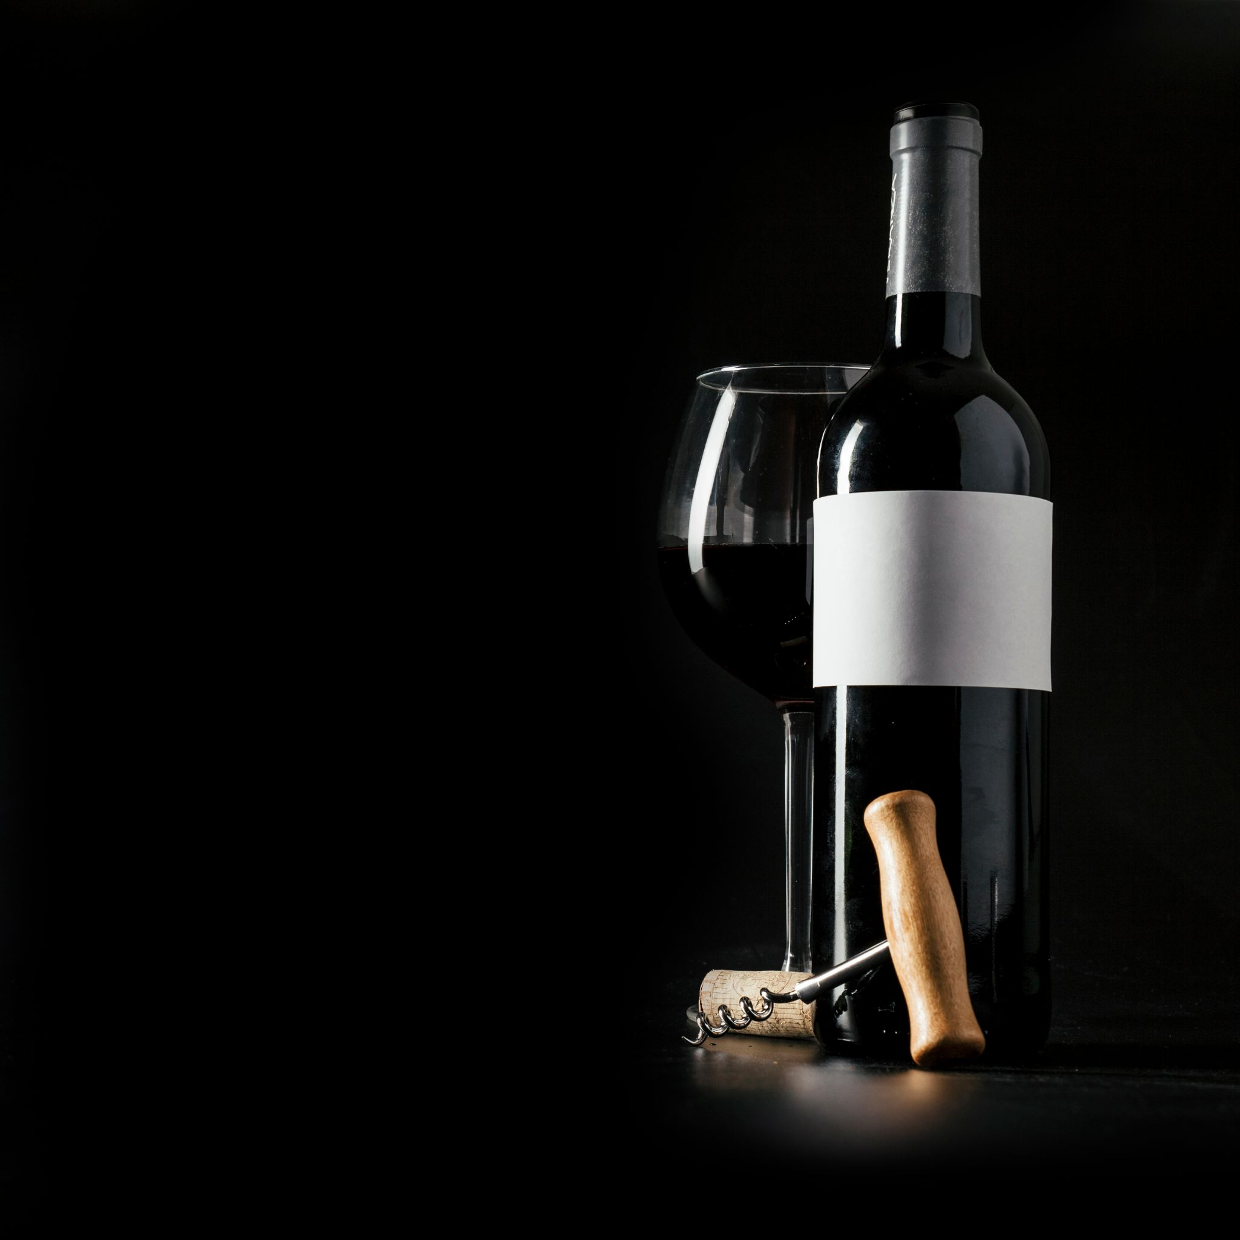
THANKS

